Slide 1
Phantom Powered Balanced Piezoelectric Contact Microphone
Designed and built by Anand Lobo

Slide 2
Types of Microphone
Dynamic (unpowered, basically a speaker in reverse)
Condenser (uses an “electret”, requires power for circuitry)
Condenser mics can have a battery or use “phantom power”

Slide 3
Balanced Vs Unbalanced audio
Unbalanced: requires 1 signal + GND wire, most common
- any noise that affects the signal cannot be removed
Balanced: also known as “differential signal”, requires 2 signal wires
- rejects noise and (when properly implemented) boosts signal

Slide 4
Phantom power
Most commonly 48V
Only usable with balanced signal wires
Avoid batteries
48V allows larger headroom (loudness before distortion)

Slide 5
My microphone design
Three parts:
Balanced piezoelectric disc (the actual “pickup” transducer)
the transducer alone can be used when phantom power is not available
however, without the preamplifier it will sound similar to cheap piezoelectric pickups
TRS-XLR cable required (normal guitar cable will not work with preamp)
Phantom-powered preamplifier
Specifically called a “microphone” to avoid association with commercially available instrument pickups

Slide 6
The problem and solution
Piezoelectric microphones do not sound good when connected directly to common audio inputs.
Technical name: impedance mismatch. Piezoelectric discs are high-impedance and audio inputs are low-impedance
Because of this impedance mismatch, bass frequencies are completely lost, leaving only a harsh, bright, tinny sound that is associated with “piezo” pickups
The preamplifier solves this by acting as a ‘buffer’ between the piezo disc and the audio input.

Slide 7
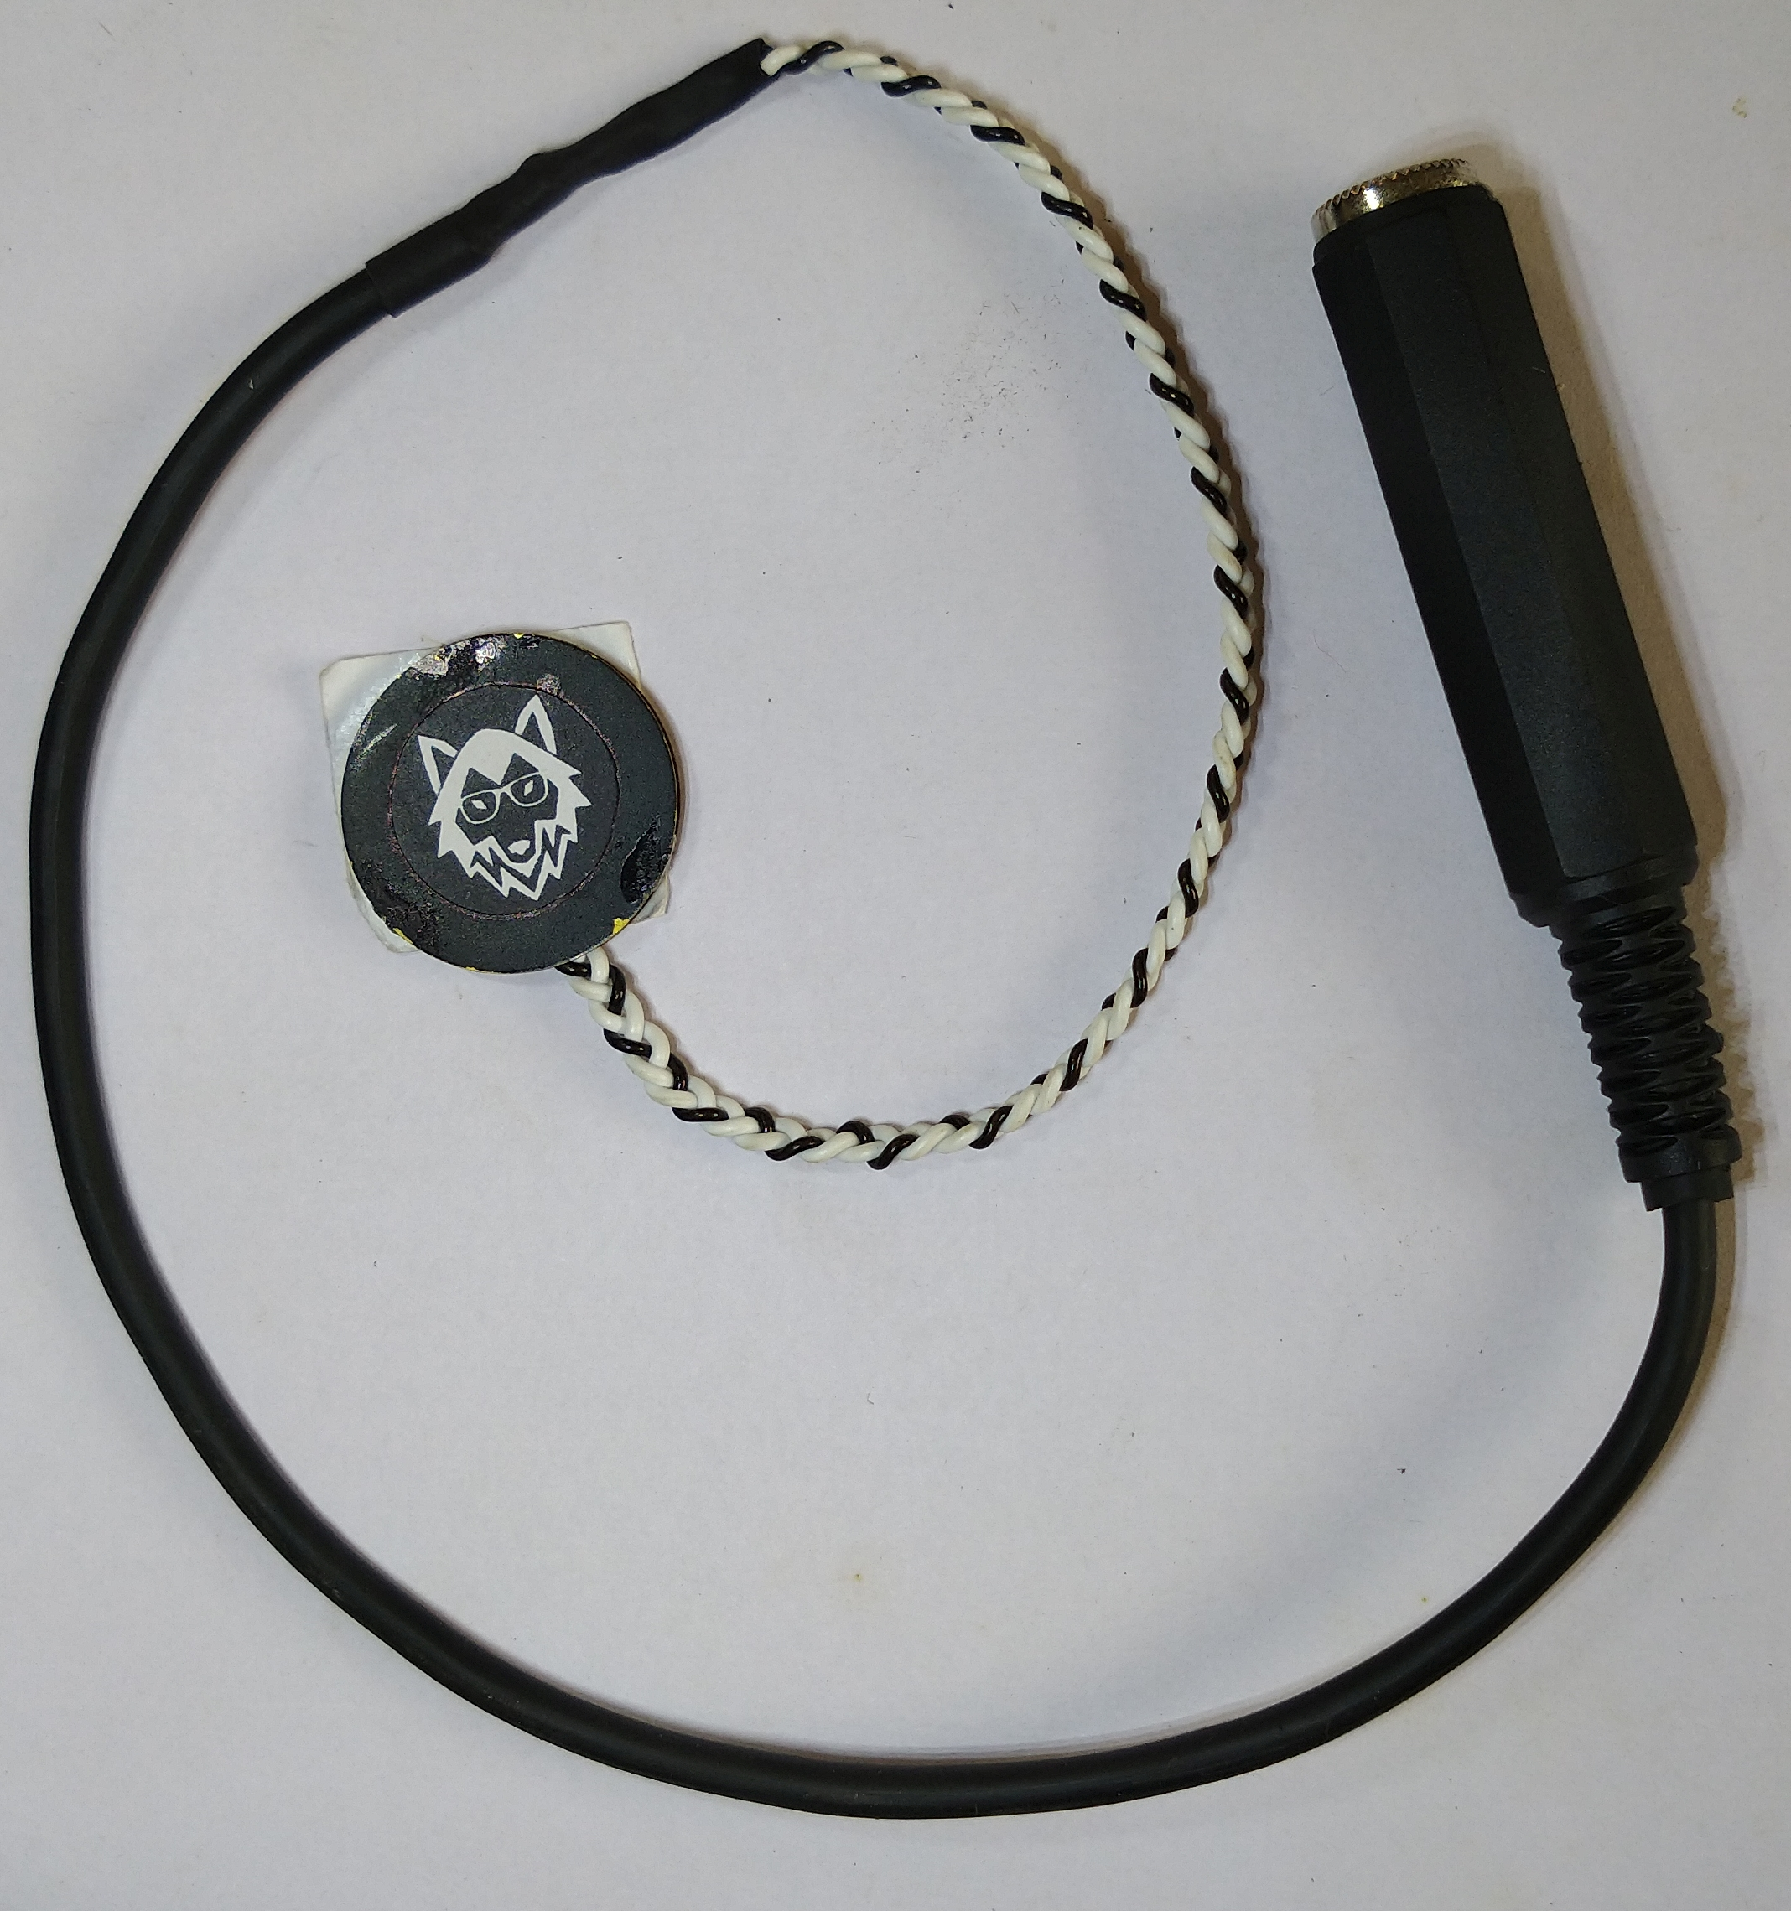
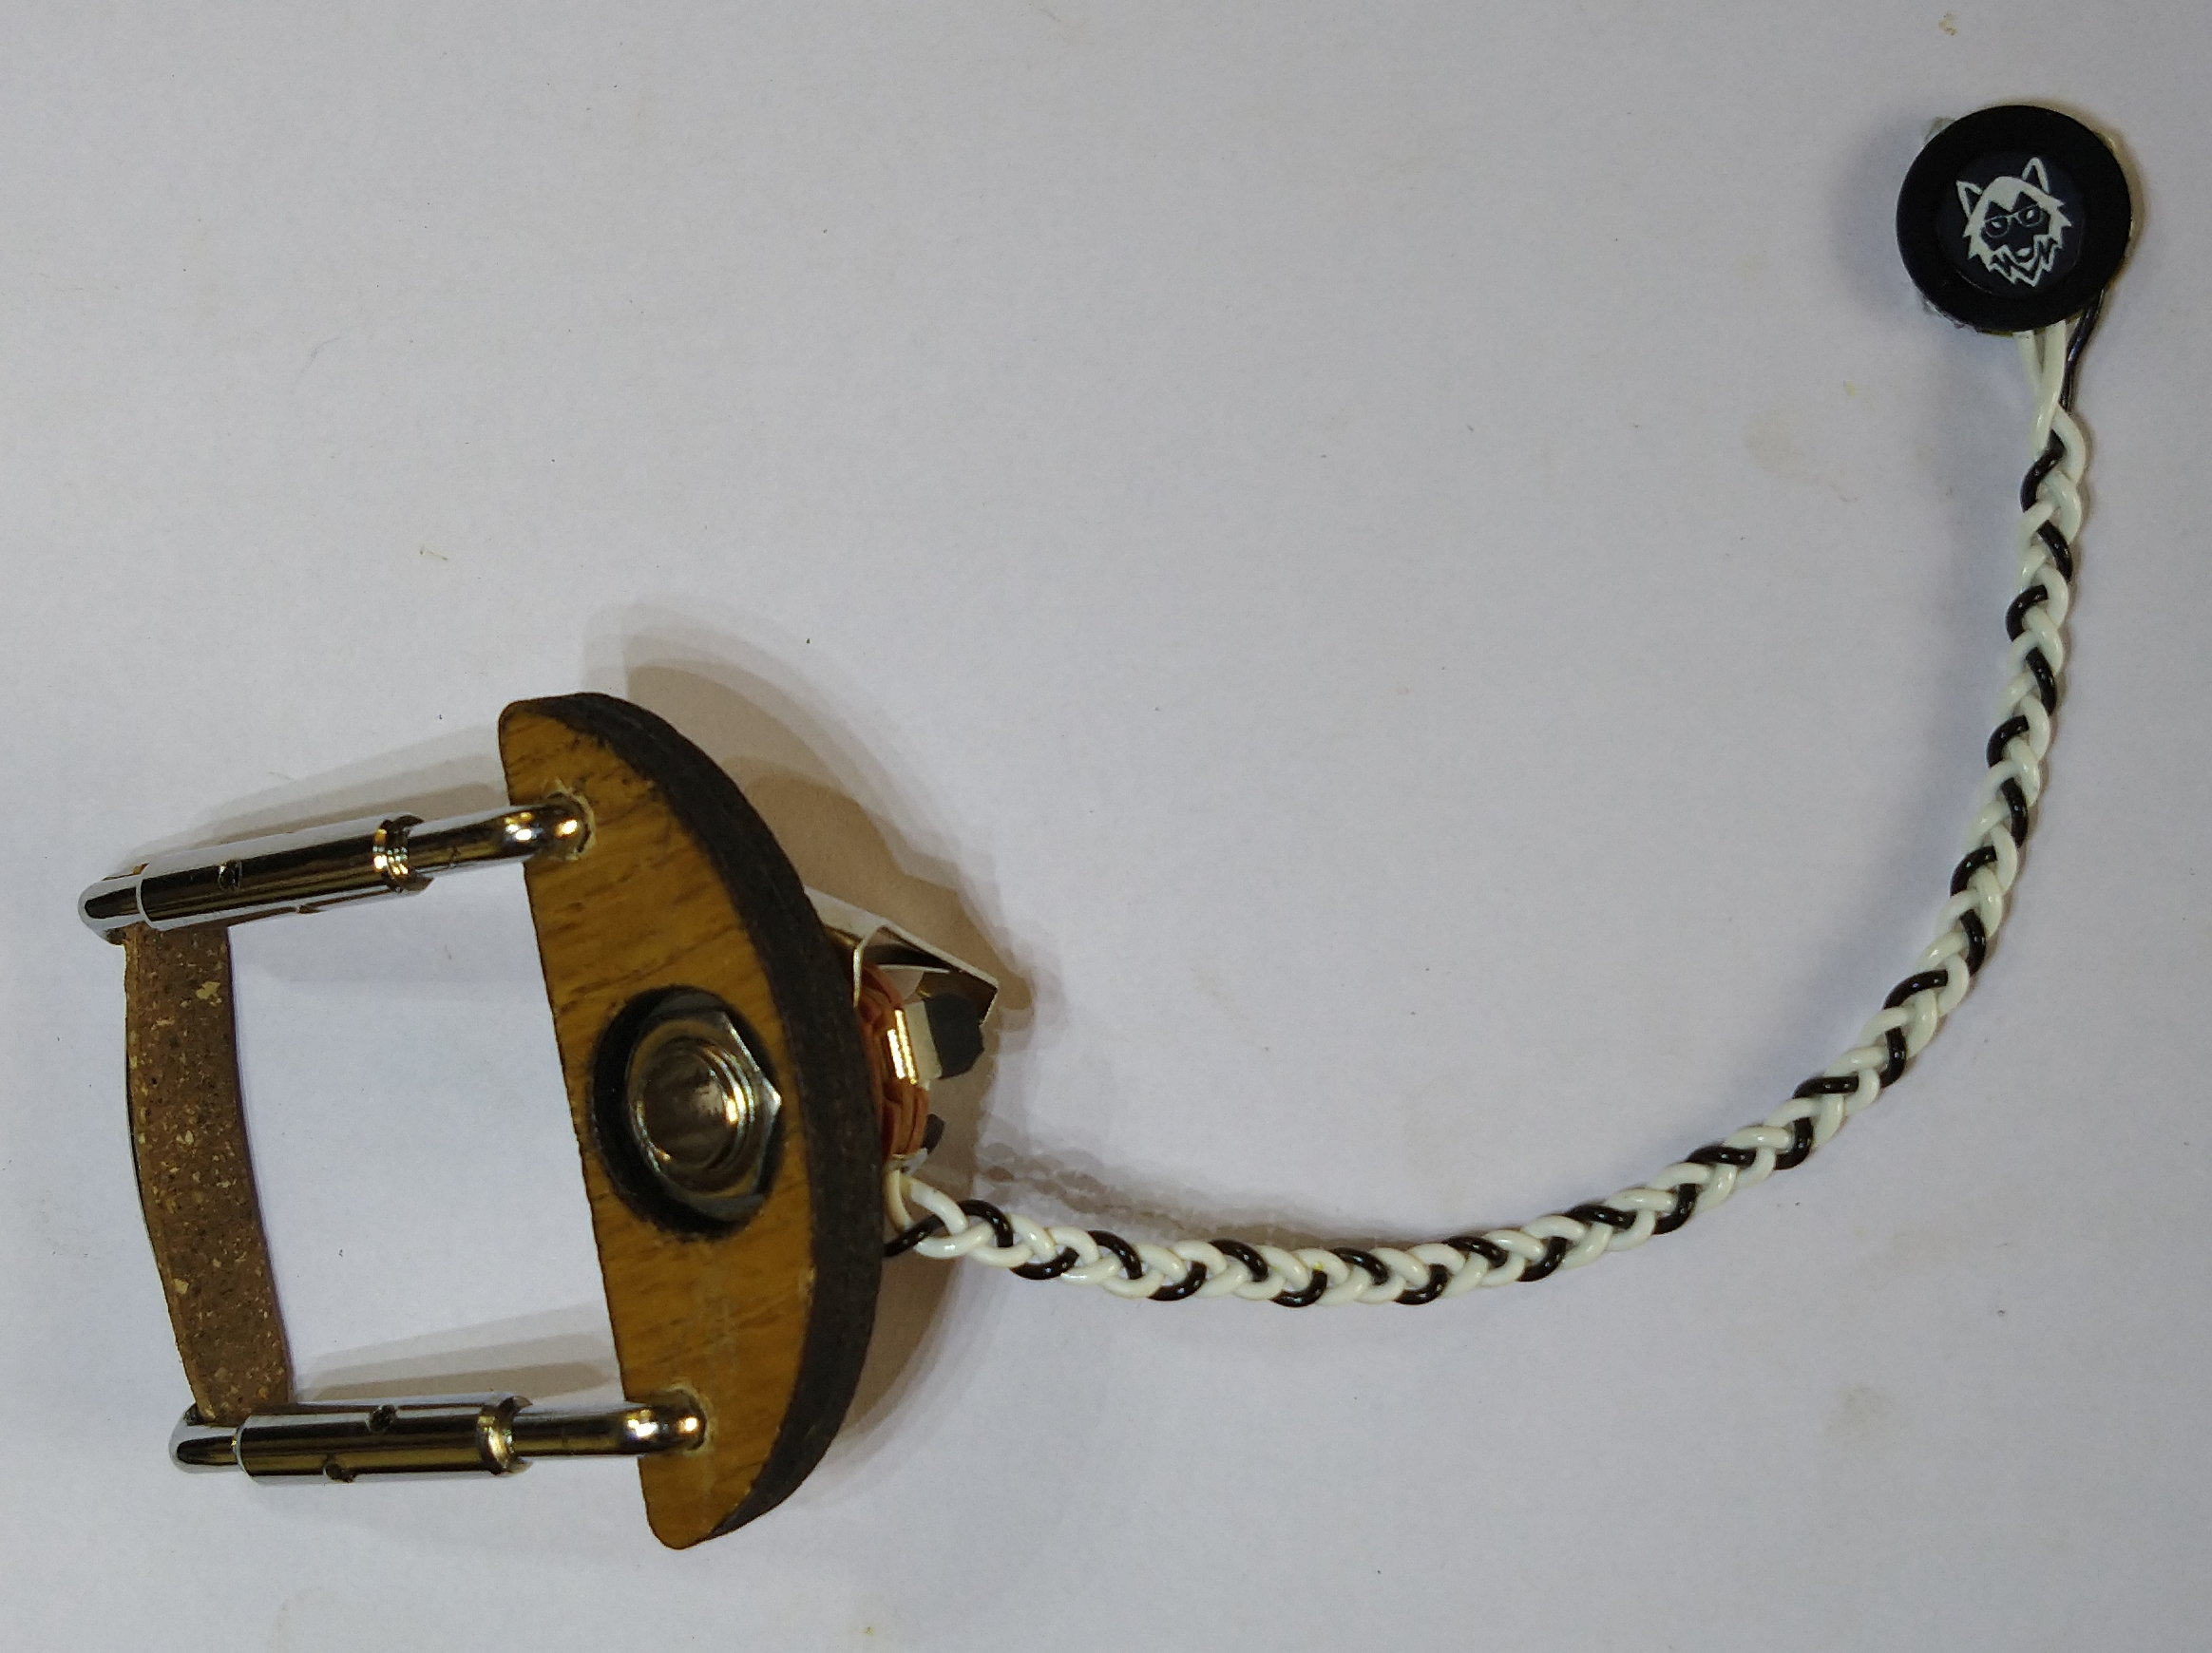
The Transducer
Model for “general” instrument use
Clamp and mount for violin / viola

Slide 8
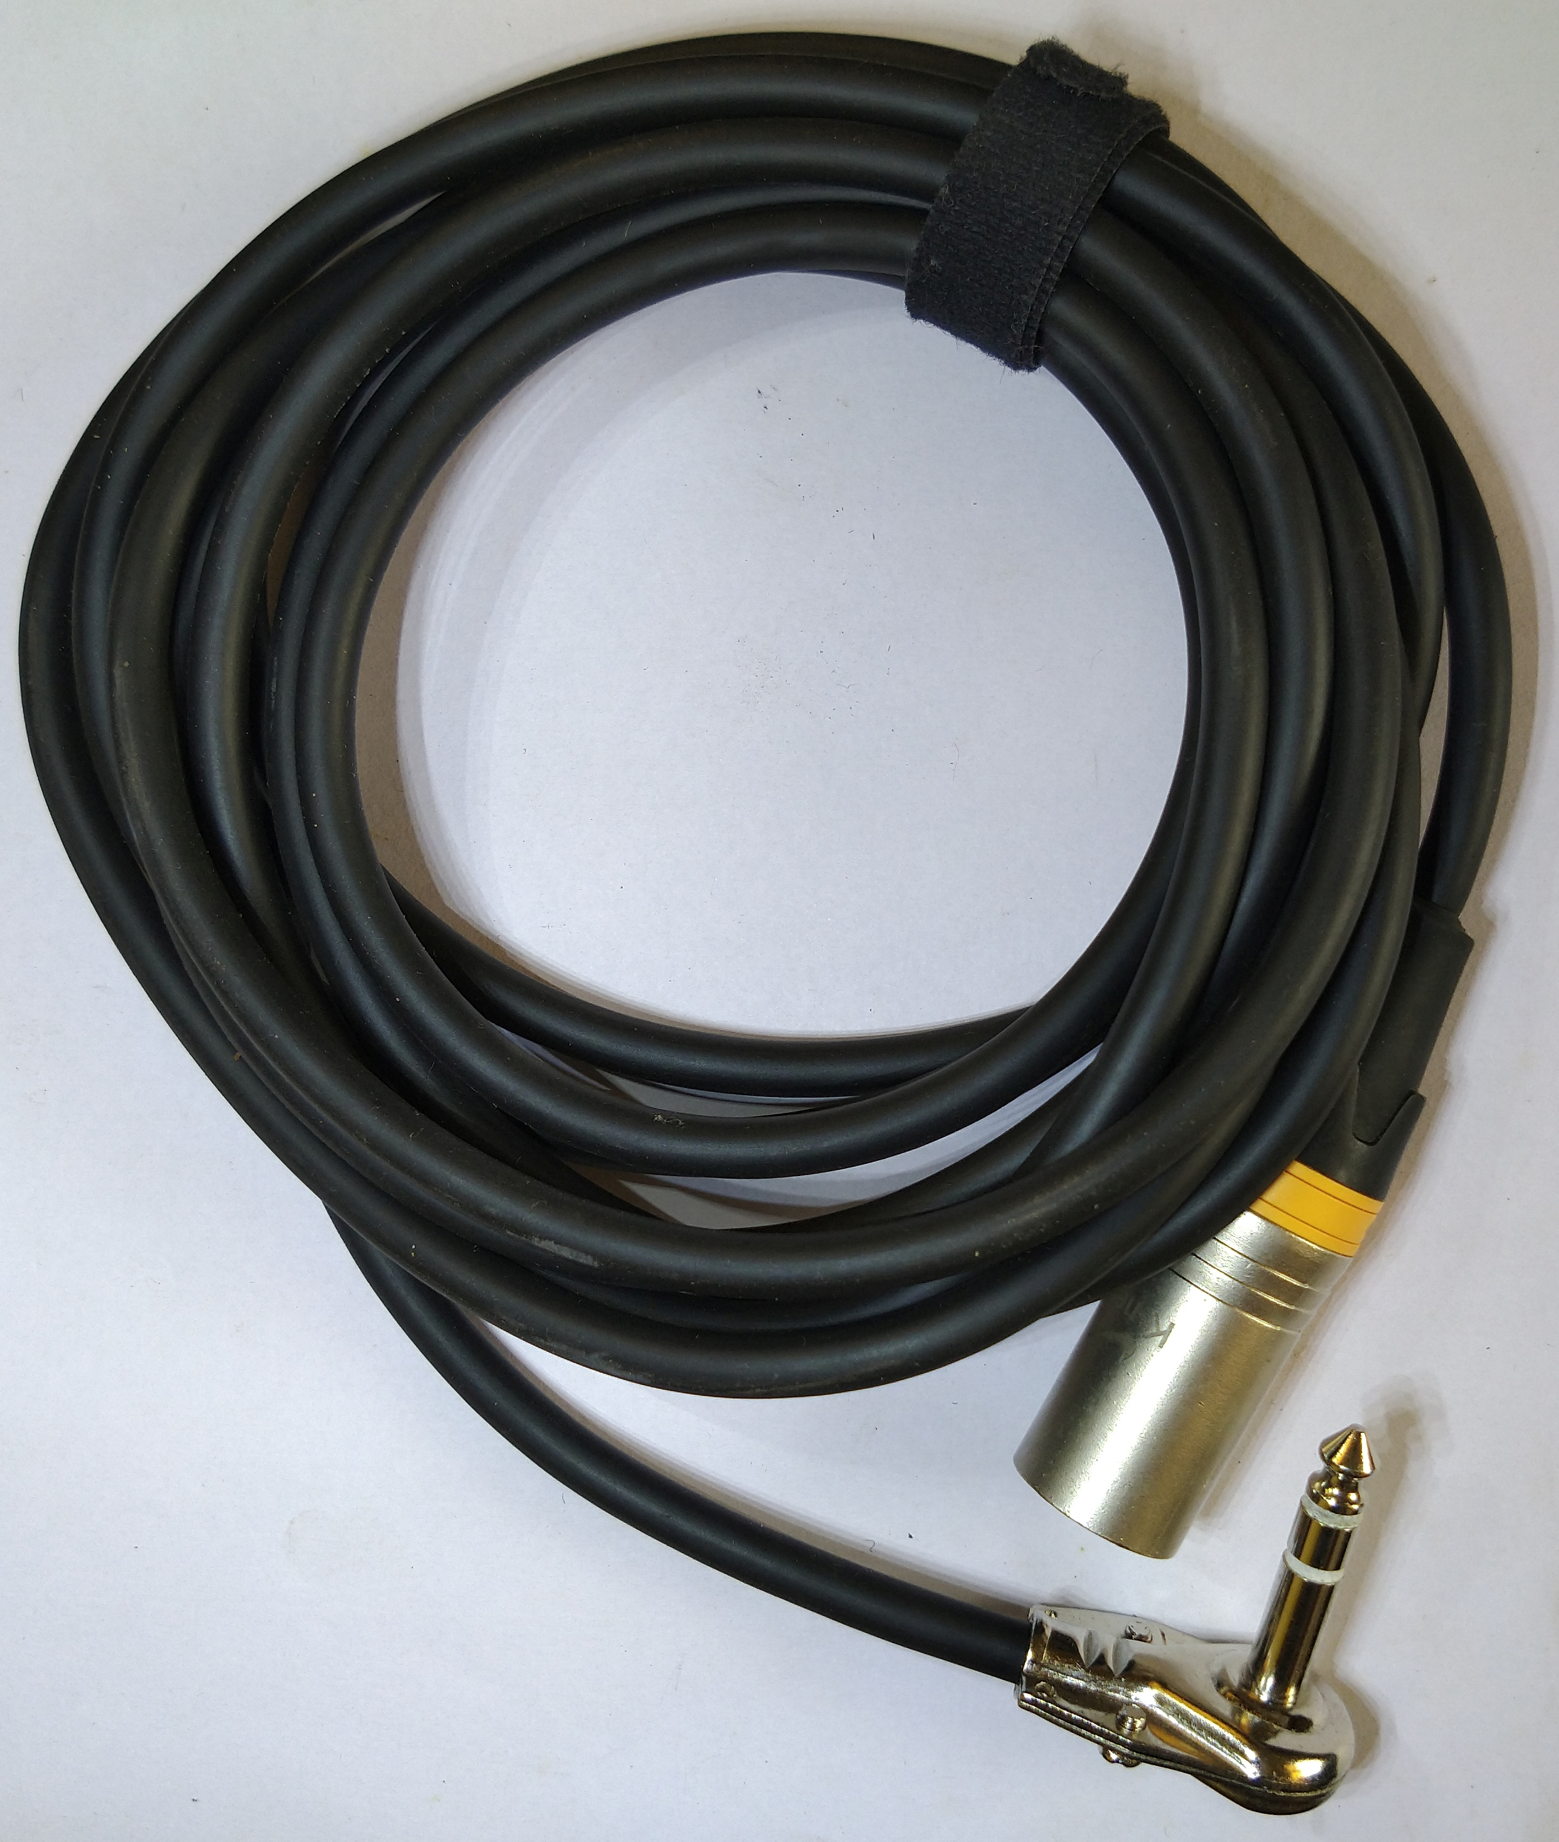
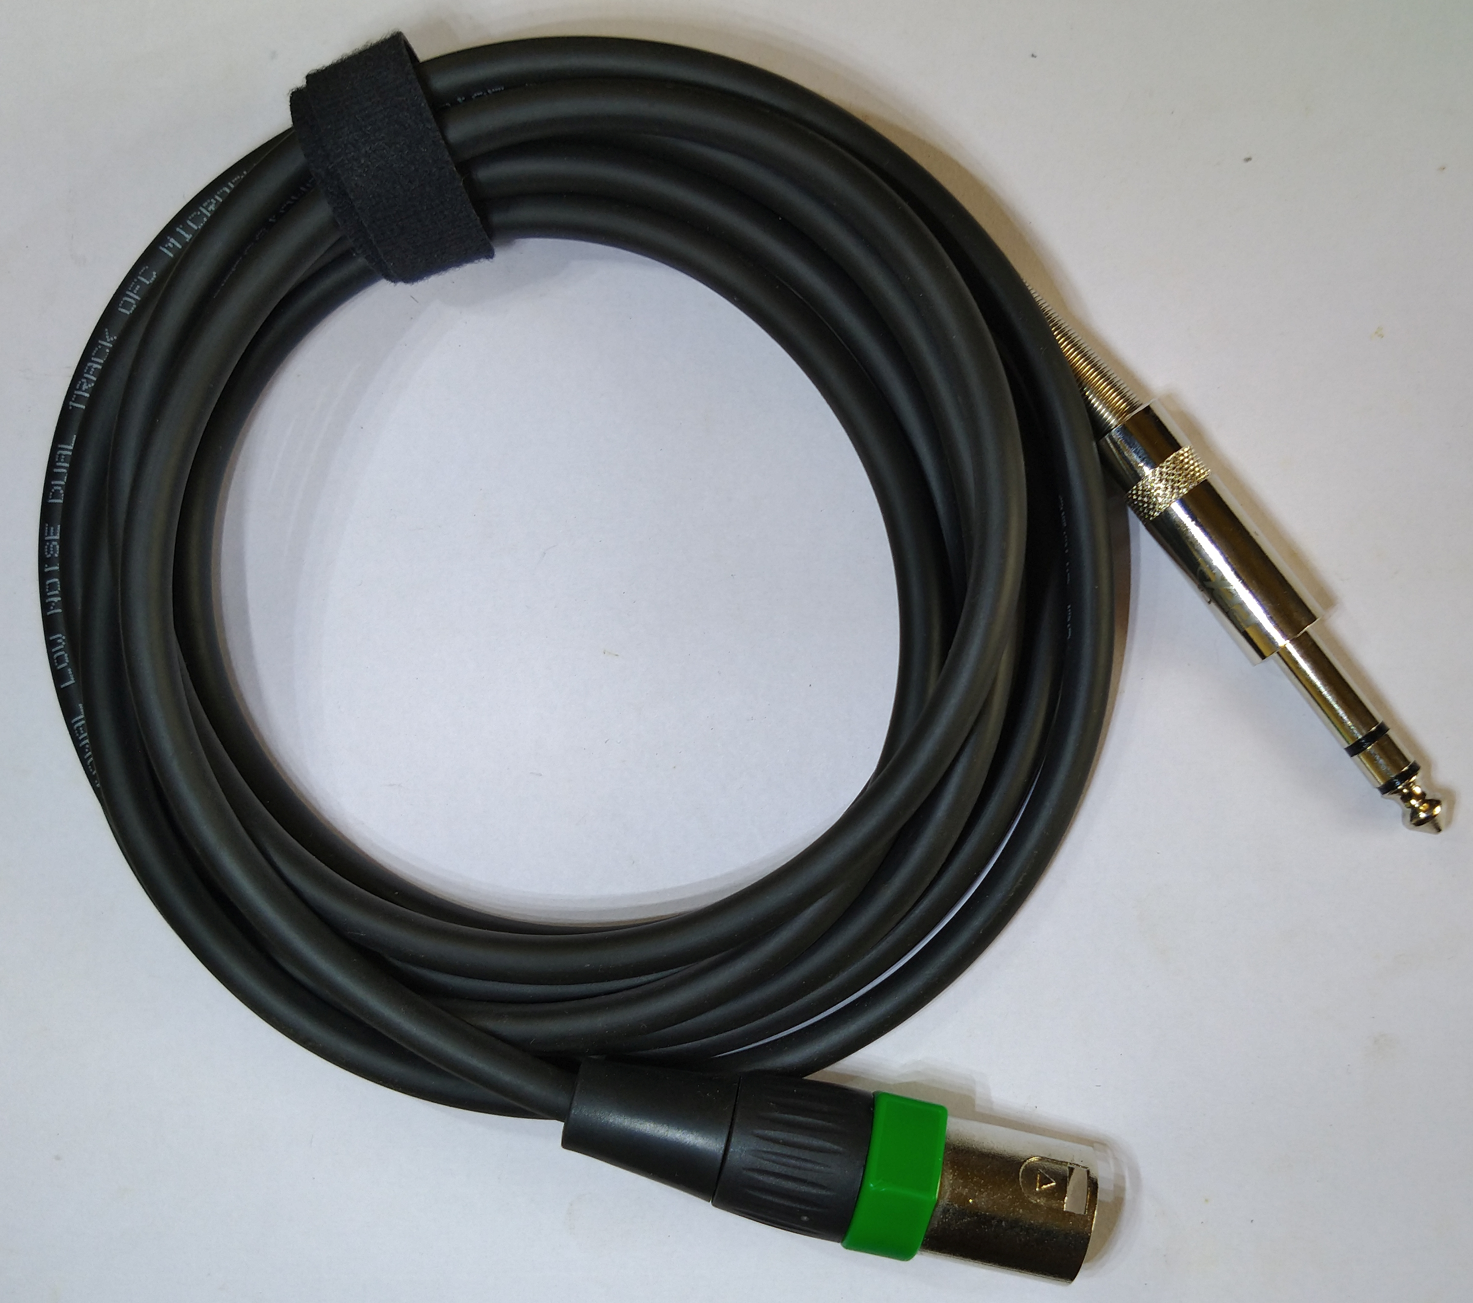
The TRS-XLR cable
90-degree connector for violin/viola
Straight connector for other instruments

Slide 9
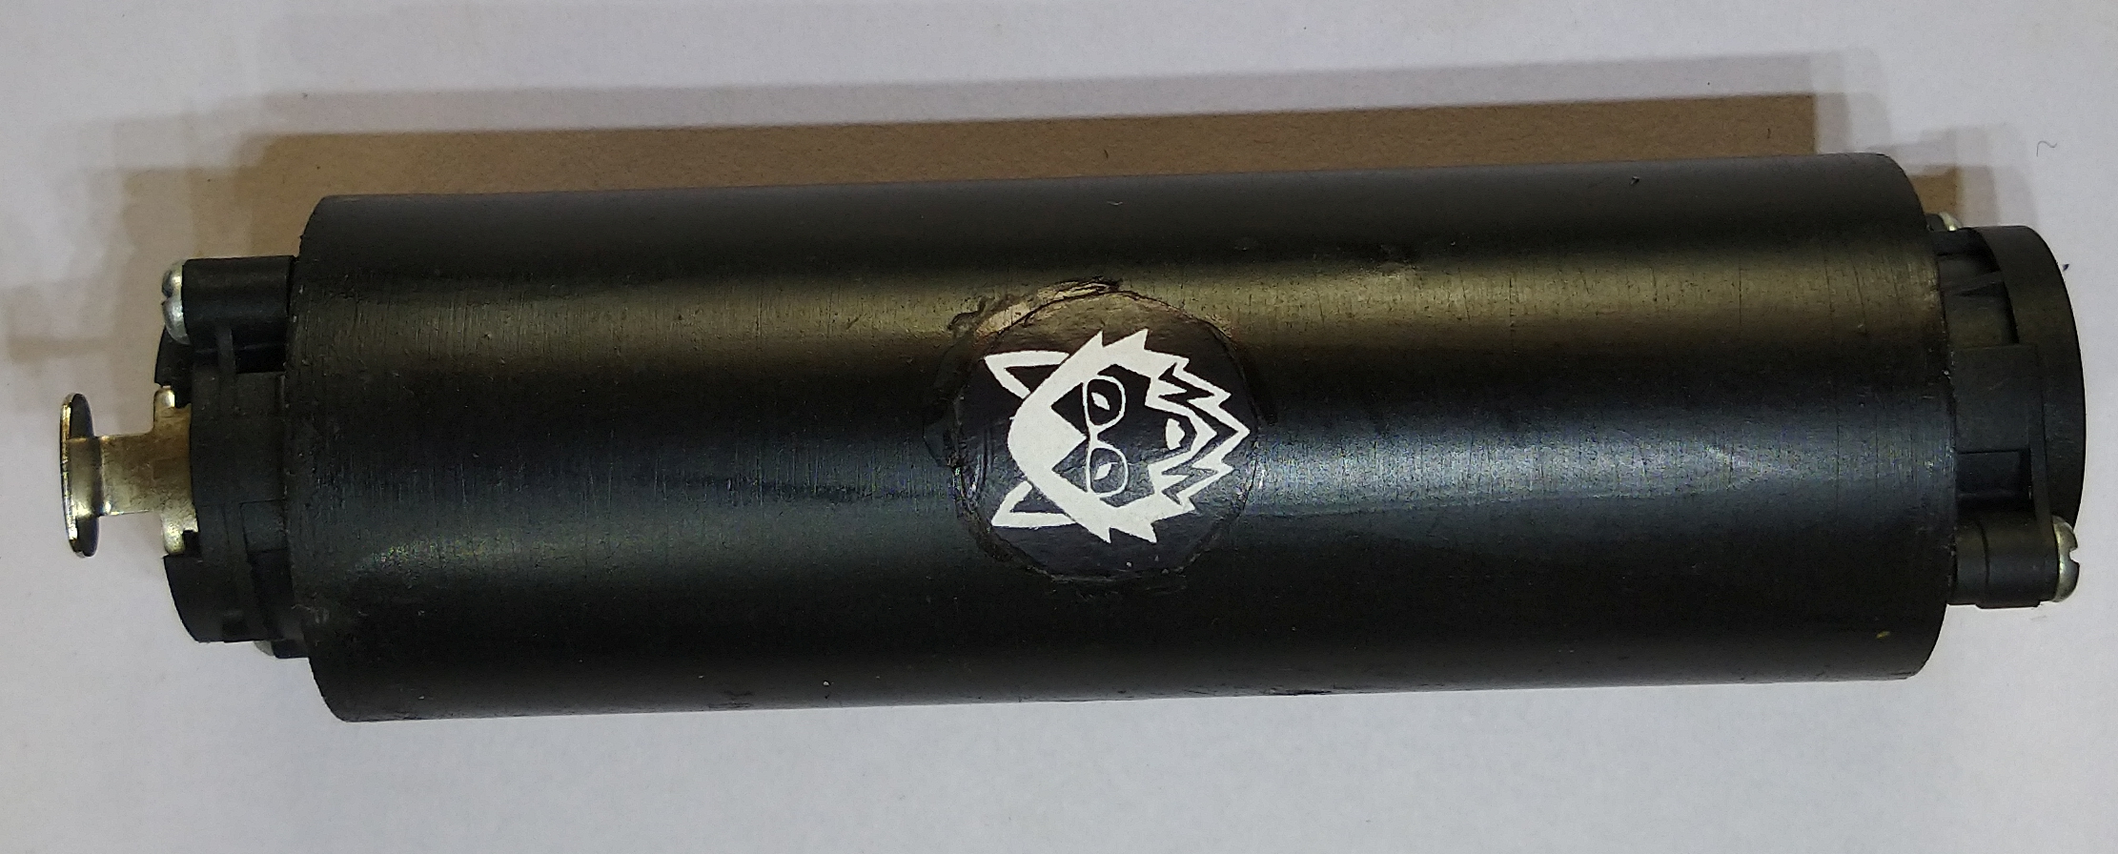
The Preamplifier

Slide 10
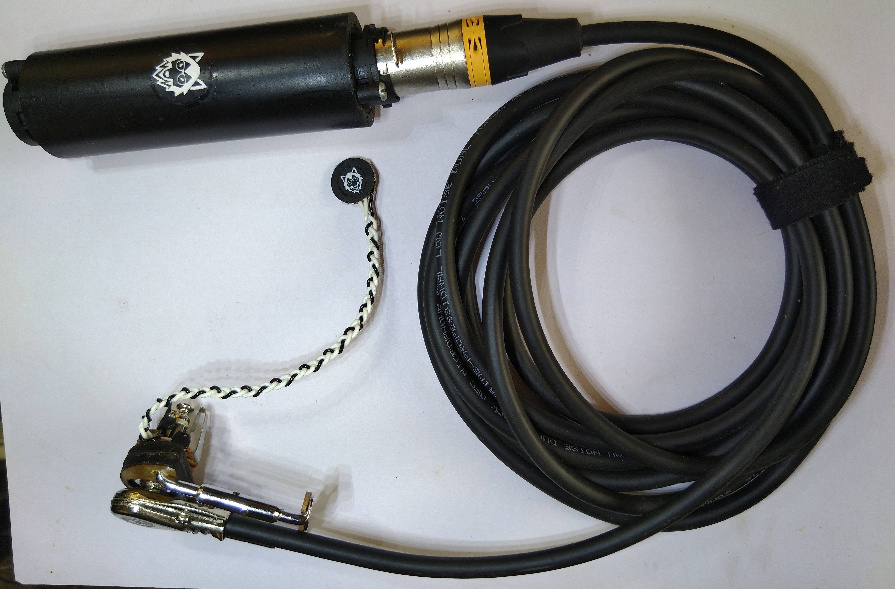

Slide 11
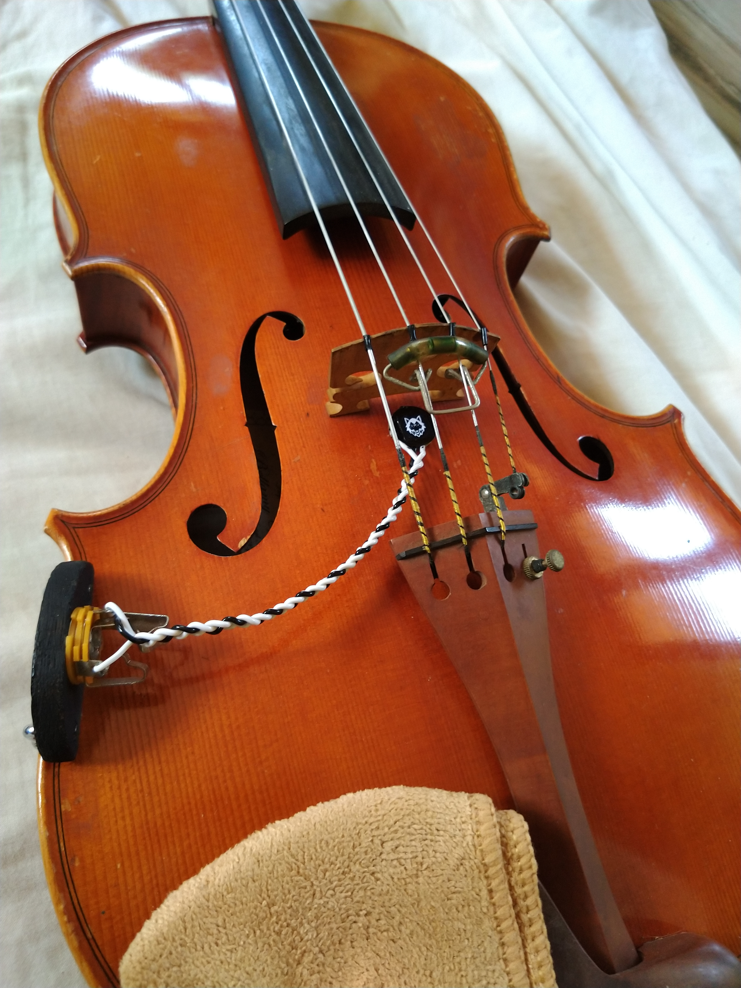

Slide 12
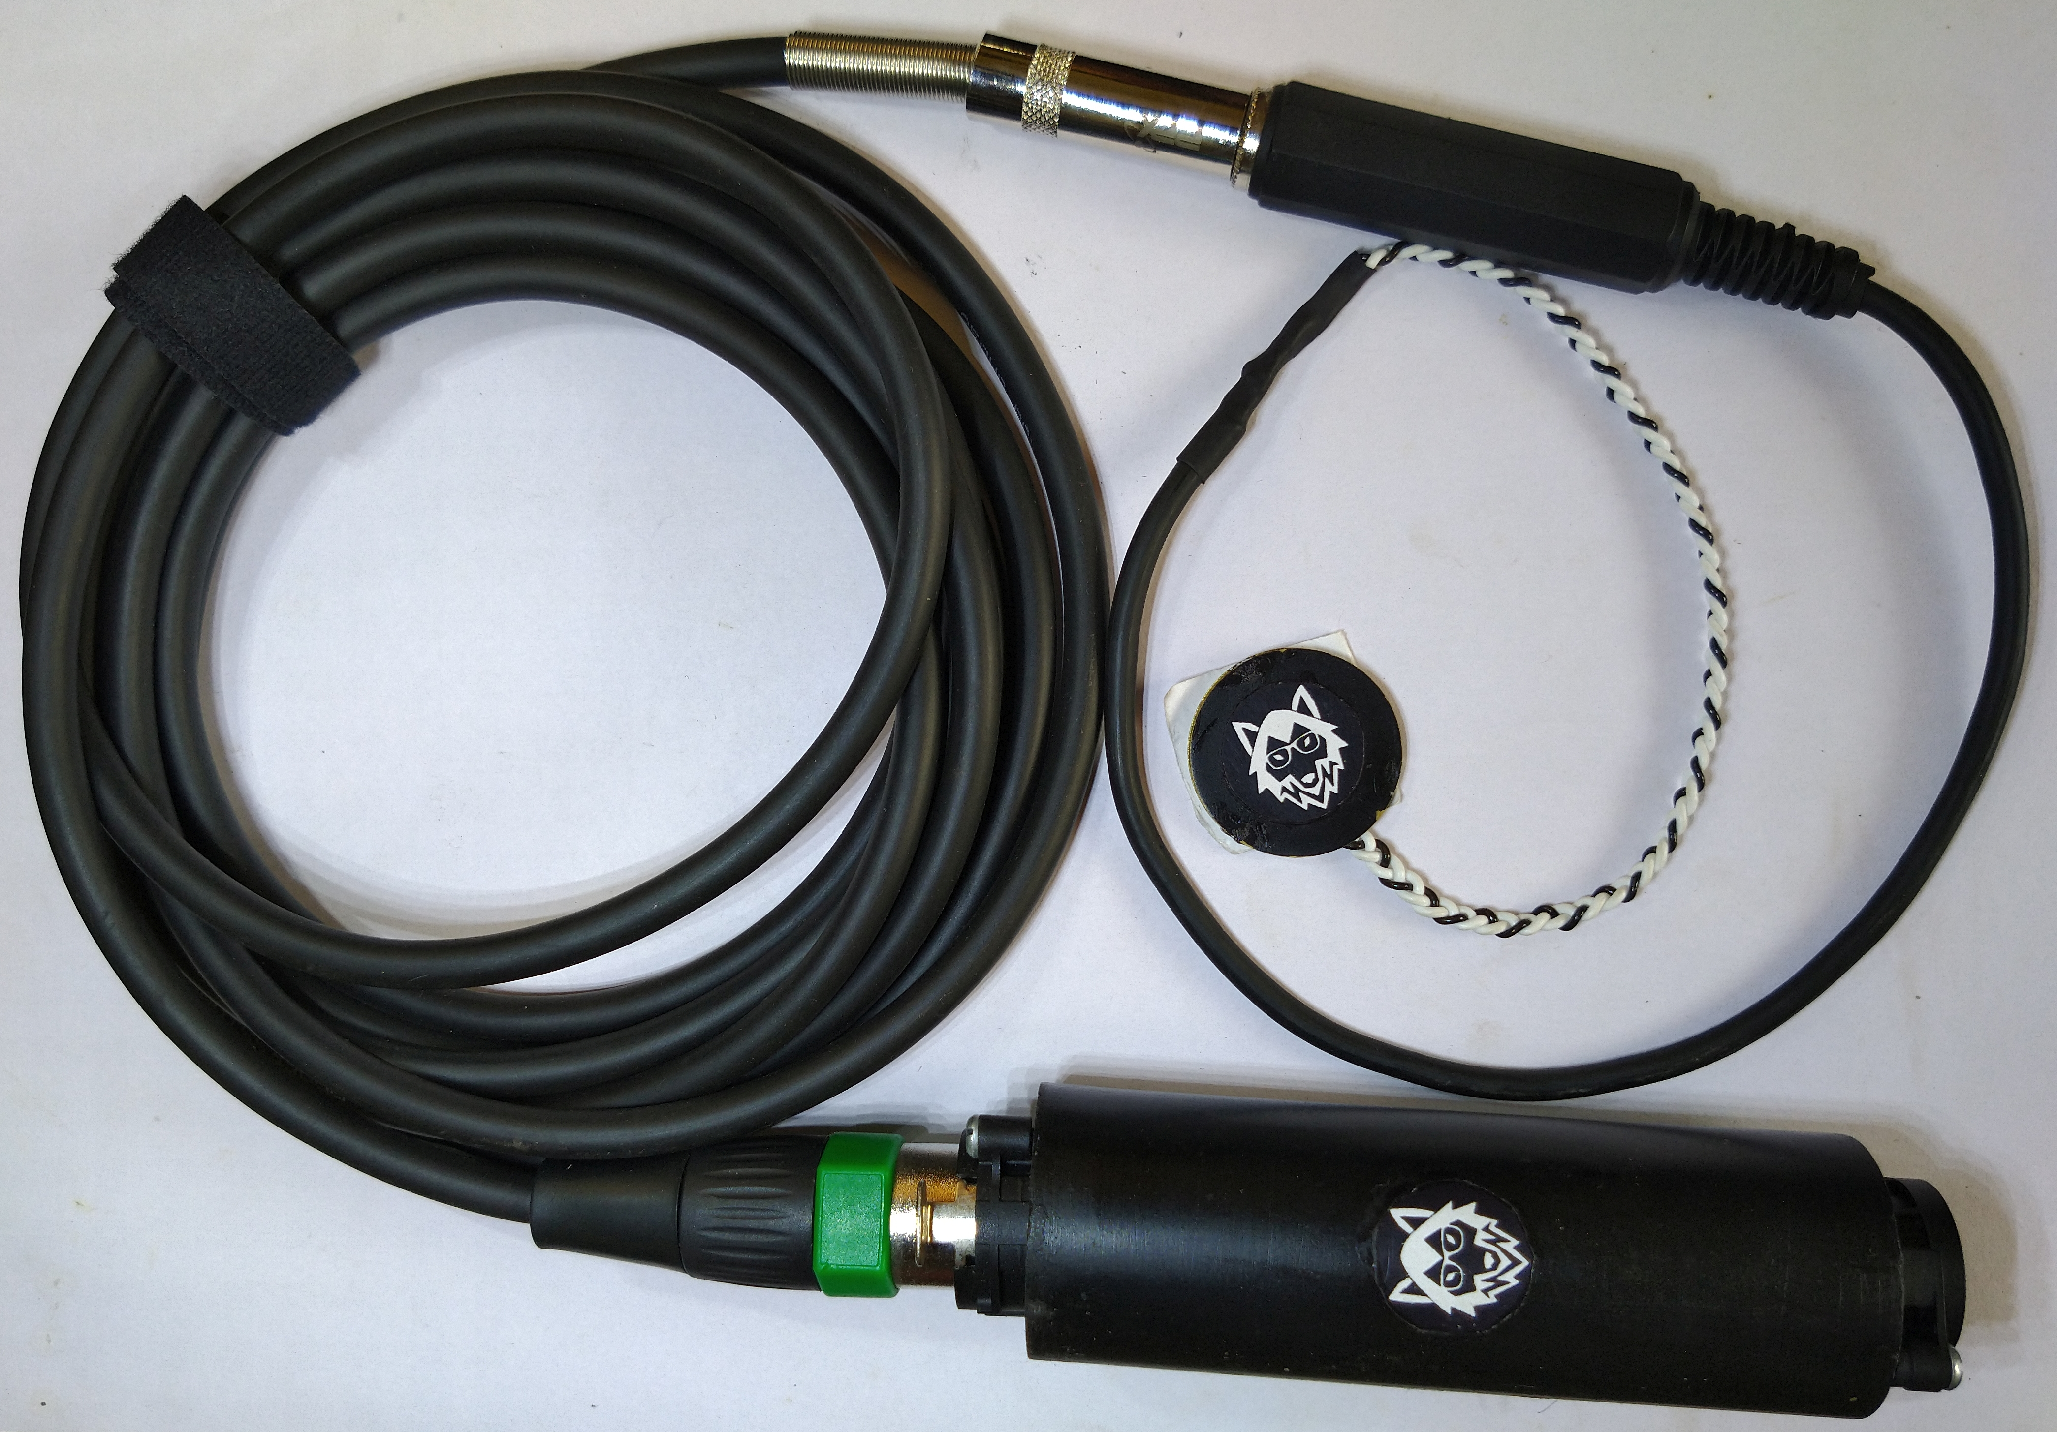

Slide 13
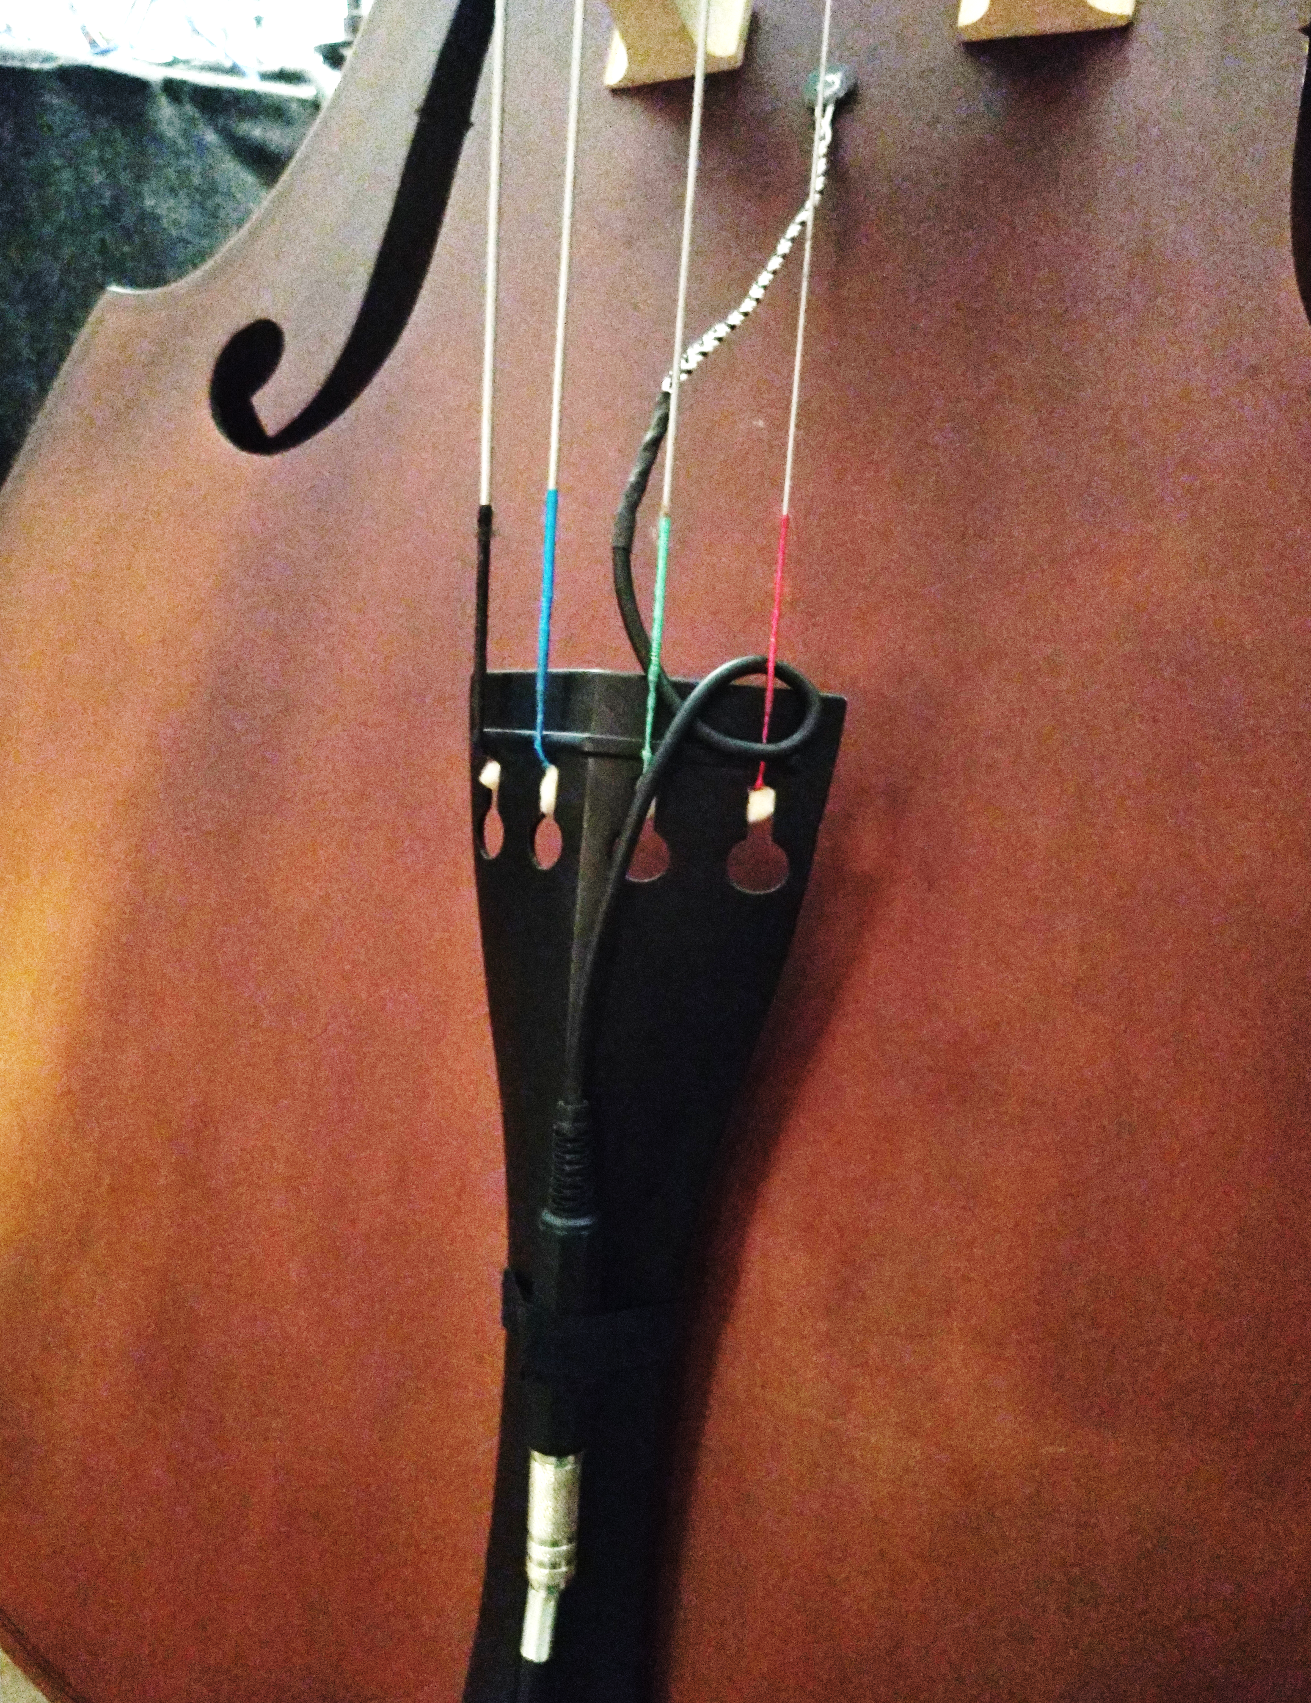

Slide 14
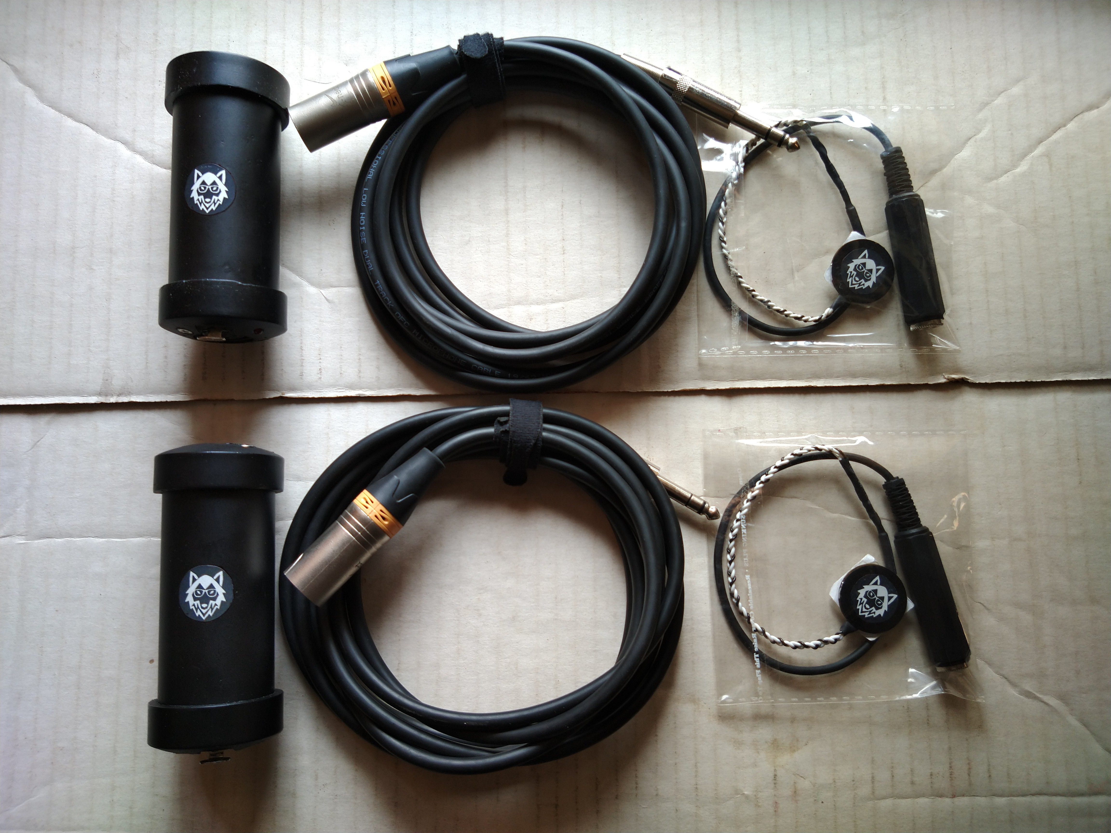

Slide 15
Main competition
AKG C-411: INR 10,000 - 20,000
actually a miniature condenser microphone
mounting solution known to leave blemishes/marks
Fishman V-200: INR 15,000 – 25,000
mounts to bridge and can affect timbre
additional preamplifier required for best sound quality
LR Baggs / Barcus Berry / similar
cheap piezo mics available online and in stores (no preamp and no instruction)
normal vocal / instrument microphones
Shure
Sennheiser
Neumann
AKG

Slide 16
Use Cases
Can be used on any hollow-body resonating instrument
successfully tested with violin-family, guitar-family, piano, kalimba (see website)
Indian instruments
Nature recording
ASMR / object recordings (e.g. tables, walls, appliances, etc)
Seismometer (?)
Industrial monitoring (?)
Hydrophone (with suitable waterproofing)
Throat microphone / body monitoring e.g. heartbeat

Slide 17
Preliminary recordings:
https://ohnoitsalobo.github.io/pickup

